Slide 1

CS302 Design and Analysis of Algorithms
Muhammad sohail afzal

Slide 2
Floyd Warshall Algorithm
Video Link (for creation of Pi-table only)
https://drive.google.com/file/d/1PPMFFo6IsCAuukADdvEwfqDMGswHQ-jy/view?usp=sharing

Slide 3
Floyd Warshall Algorithm
All pair shortest path algorithm that finds shortest path from every vertex to every other vertex
Works for directed as well as undirected graphs
Works for negative weight edges but does not work in case of negative weight cycles.
Follows dynamic approach
https://drive.google.com/file/d/1PPMFFo6IsCAuukADdvEwfqDMGswHQ-jy/view?usp=sharing

Slide 4
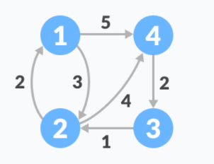
Floyd Warshall Algorithm
Suppose we have a graph :

Slide 5
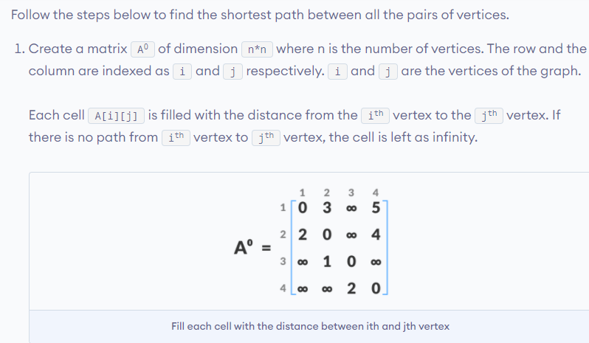
Floyd Warshall Algorithm

Slide 6
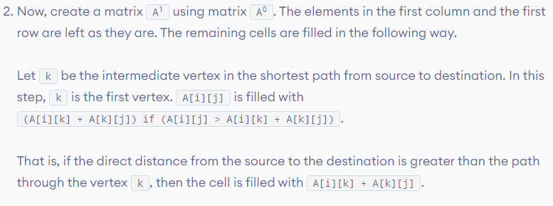
Floyd Warshall Algorithm

Slide 7
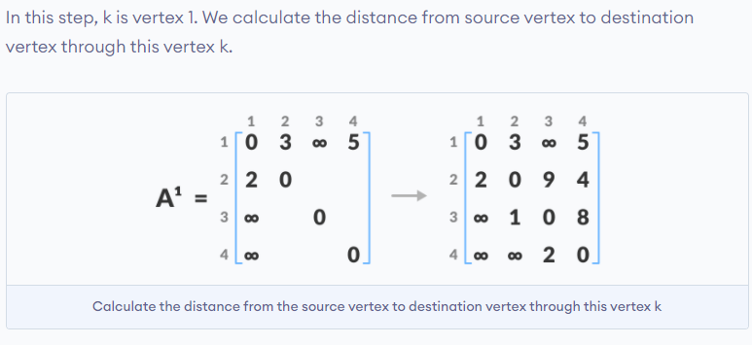
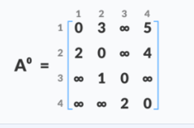
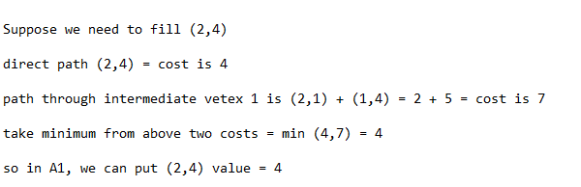

Floyd Warshall Algorithm

Slide 8
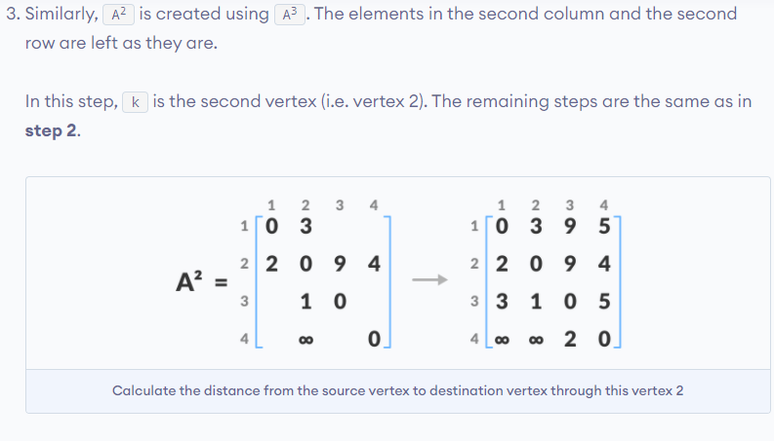
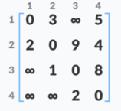

Floyd Warshall Algorithm

Slide 9
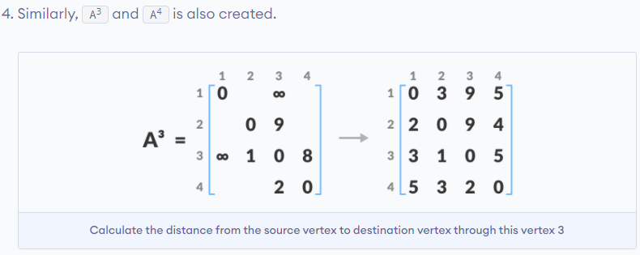
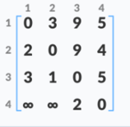

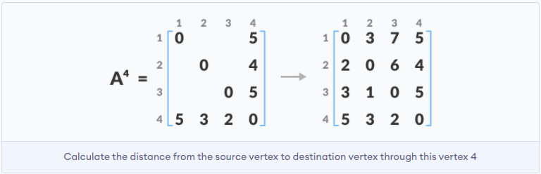
Floyd Warshall Algorithm

Slide 10
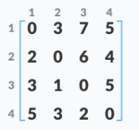

Floyd Warshall Algorithm
The A4 matrix is the final solution that is giving us shortest path from every vertex to every other.
For example: value of (1,3) in A4 is 7 which means that shortest path from vertex 1 to vertex 3 is 7. (path : from 1 to 4 and then from 4 to 3) and so on.

Slide 11
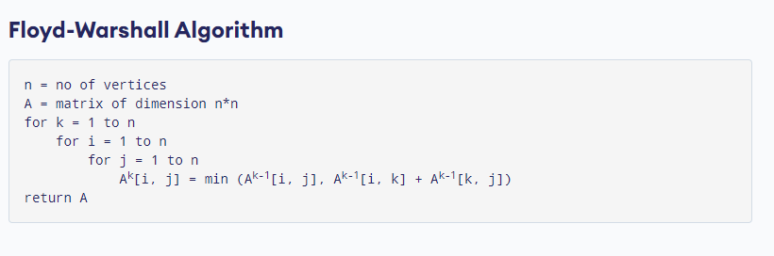
Floyd Warshall Algorithm

Slide 12
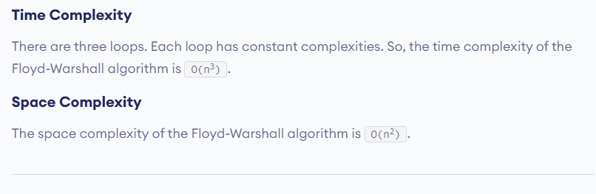
Floyd Warshall Algorithm

Slide 13
Floyd Warshall Algorithm
Applications :
To find shortest path between all vertices.
To find transitive closure of directed graphs (to find reachability among vertices)
To find if undirected graph is bipartite
and etc

